Slide 1


Deep Learning
Class 3

Slide 2
CNN
Convolutional Layers
Nonlinear Activation Functions
Pooling
Fully Connected Layers
Dropout

Slide 3
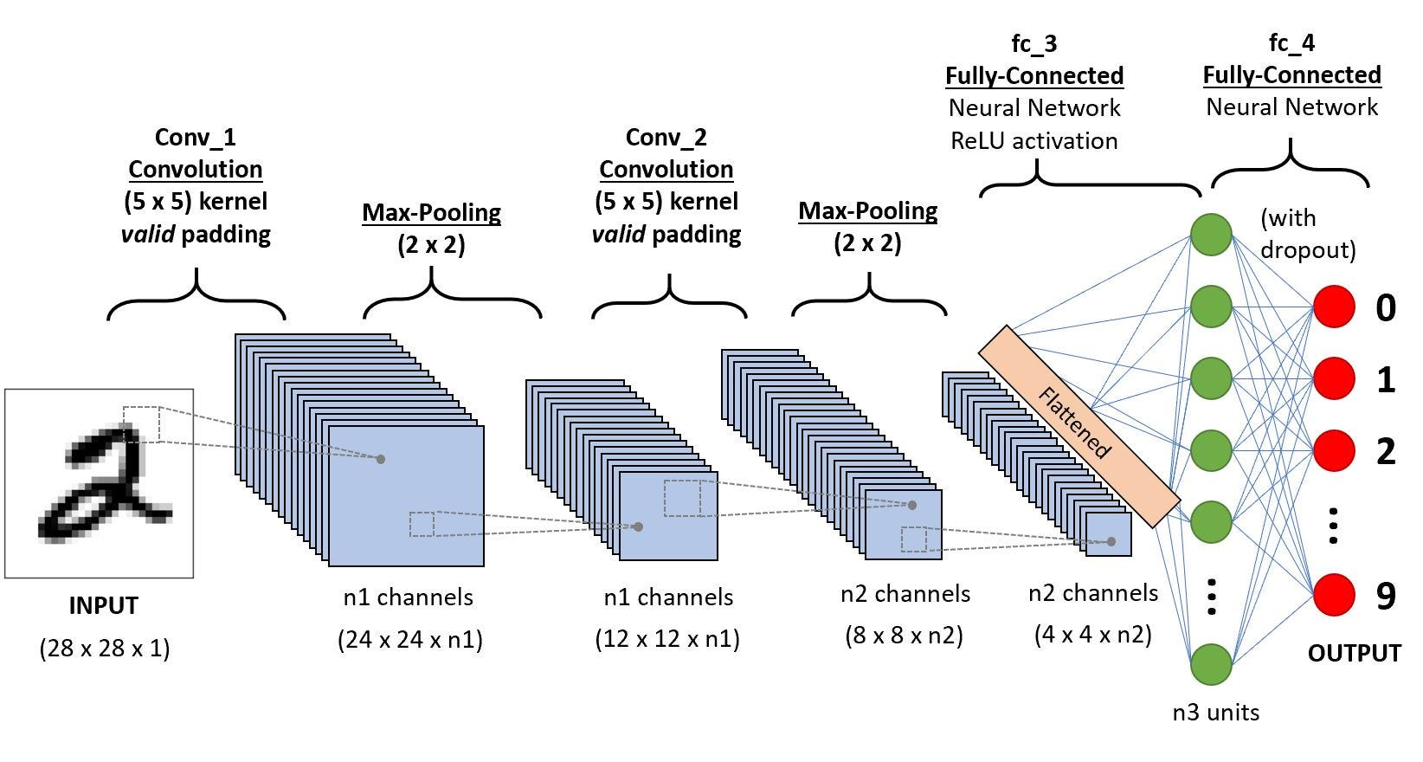

Slide 4
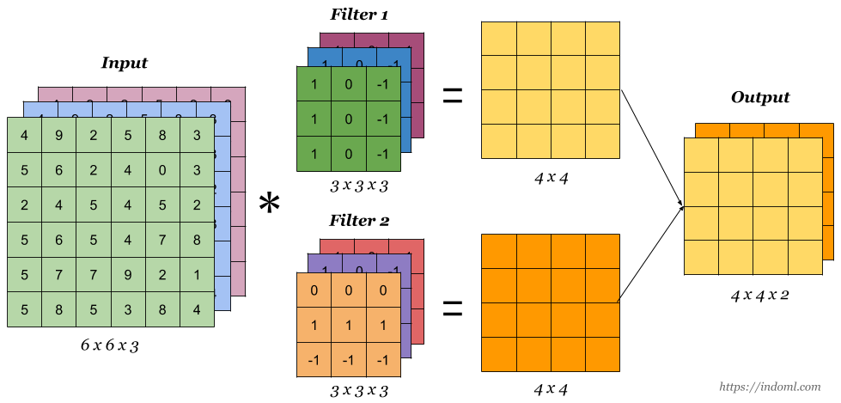

Slide 5
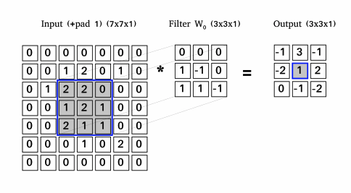

Slide 7
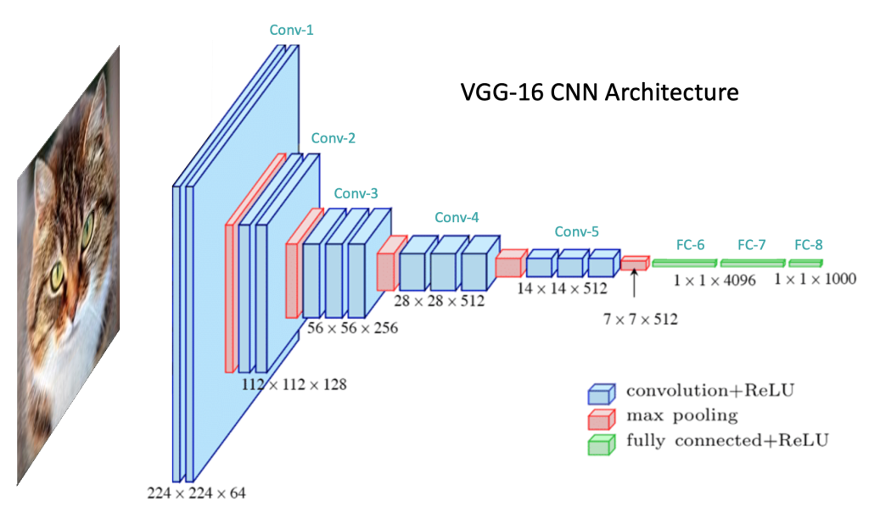

Slide 8
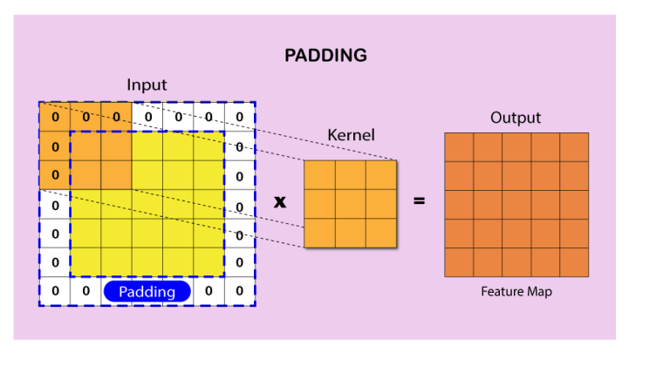

Slide 9
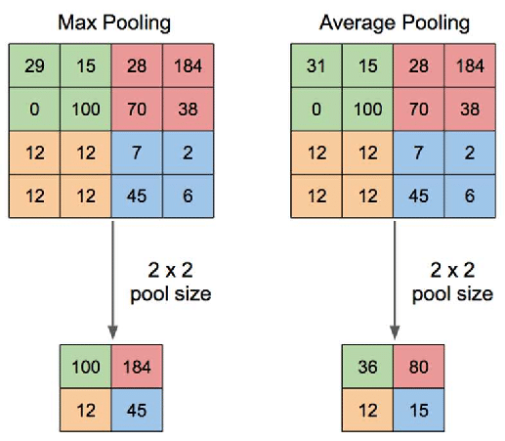

Slide 10
